Slide 1
Cognitive Labs Gary Wilson CTO & Technical Leader, UKI Commercial Business

Slide 2

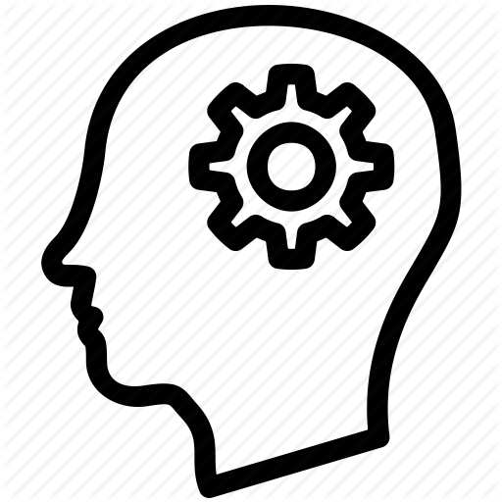

What are we going to do?
Notes:
Lab Objectives
- LEARN practical Cognitive / Watson PROTOTYPING skills
- Use those skills to BUILD something!

Slide 3
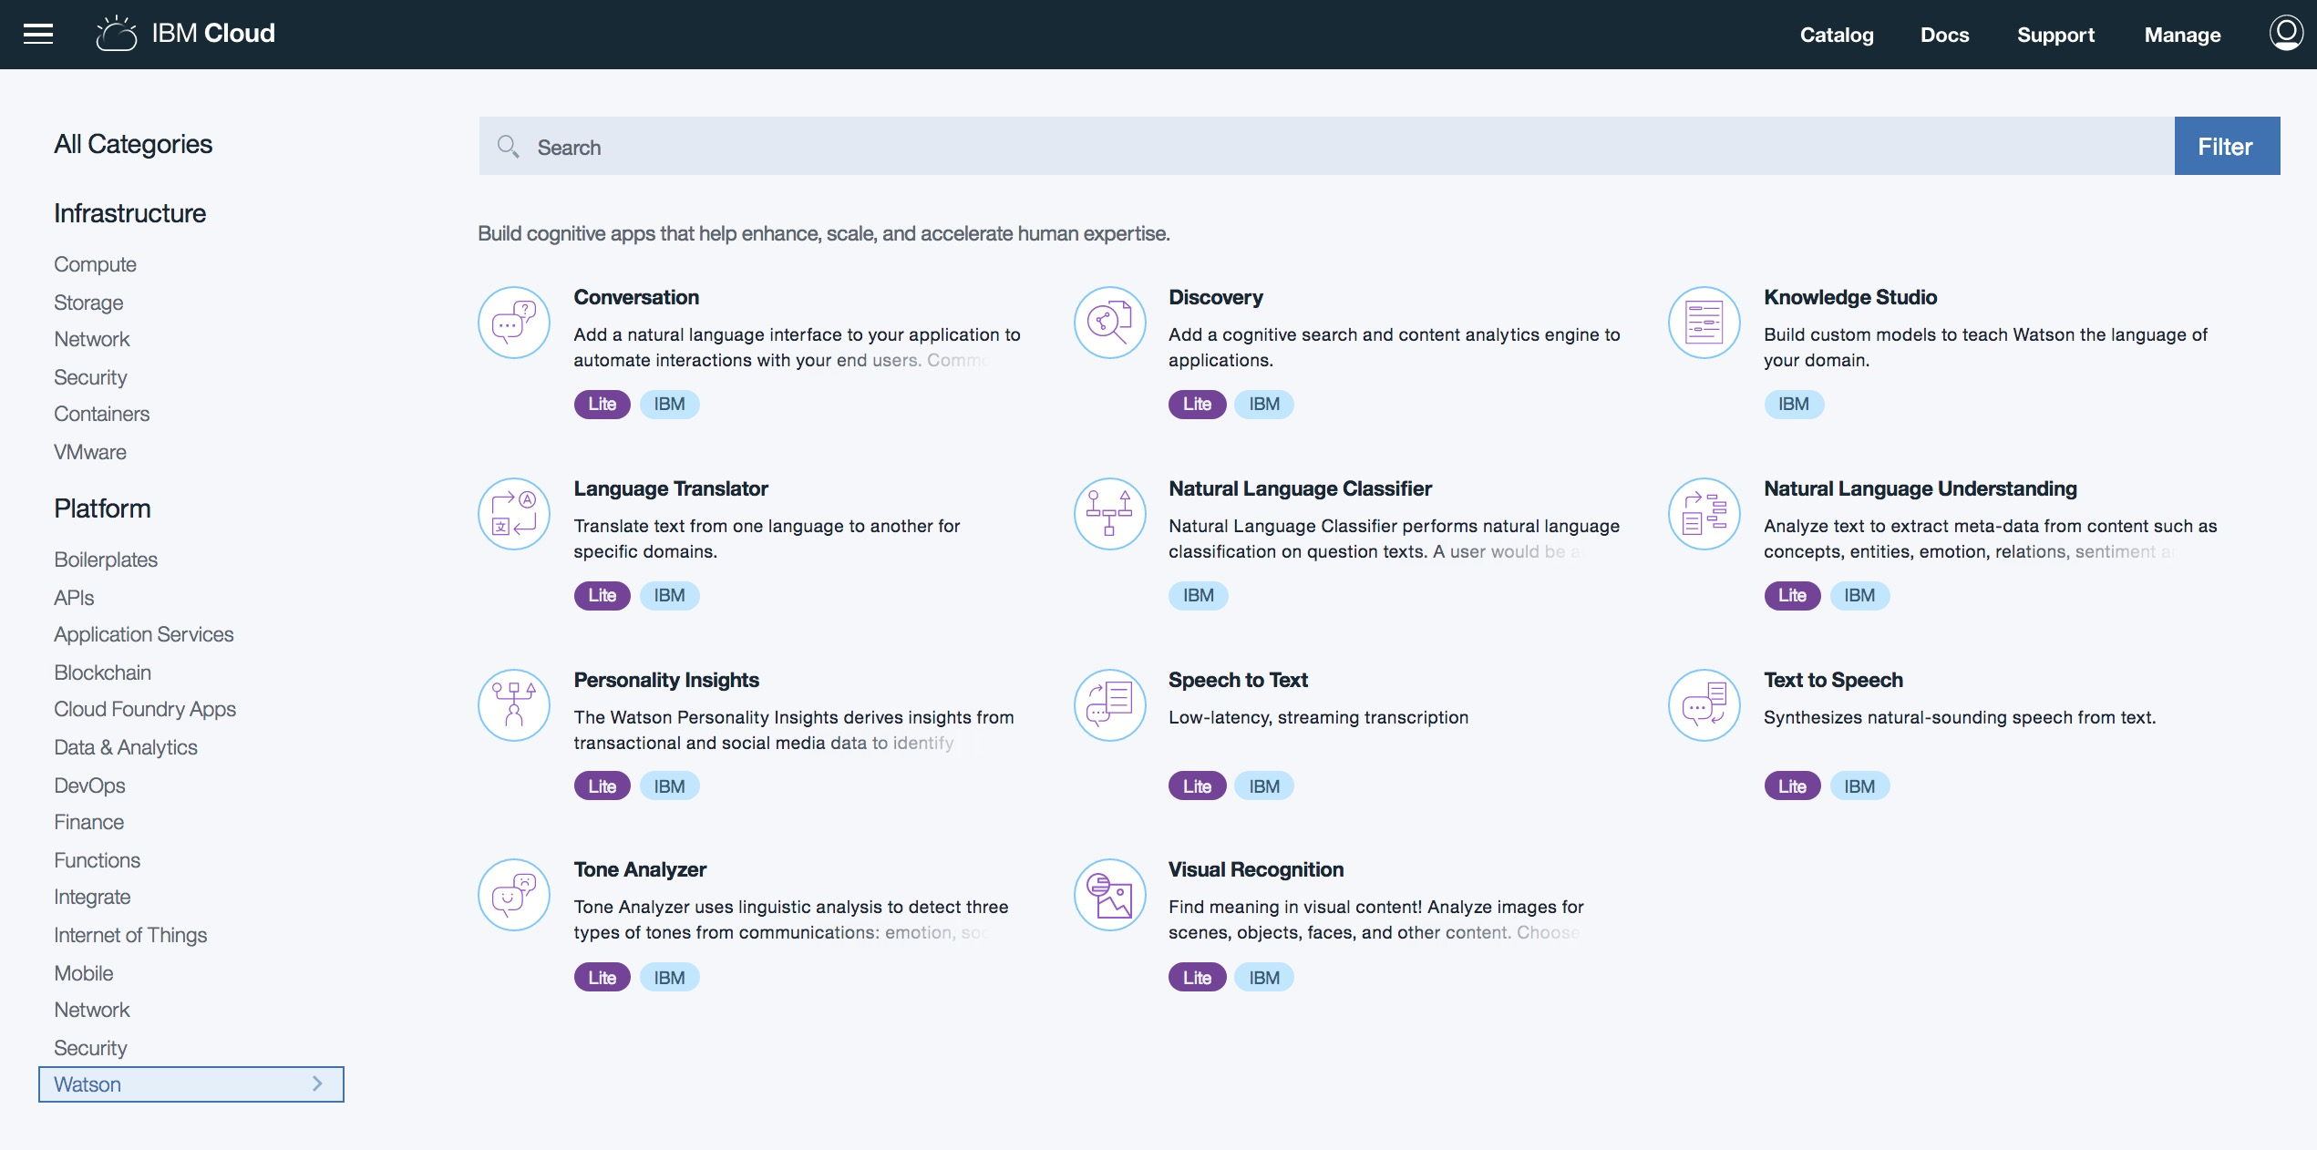
Learn: Cognitive Labs
IBM Cloud Services
Notes:
- LEARN:
- Build 2 applications using 4 Watson Cognitive services
- Conversation, Discovery, NLU, Visual Recognition
- All built using Node-RED, with minimal coding
- BUILD:
- GDPR Advisor chatbot
- Insurance Claims app
- Build your own basic prototype

Slide 4
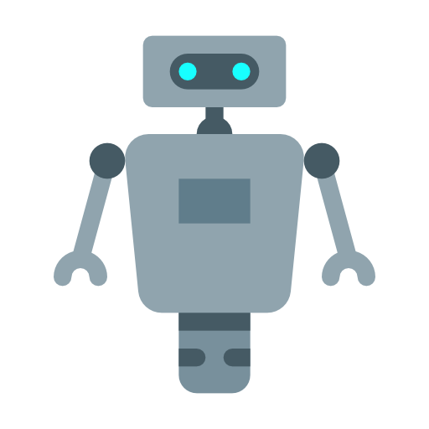
Cognitive chatbot
“I’d like advice on a new phone”
“How many times can I install an application I've purchased on the Market?”
“I’m interested in a new contract”
“My LG D800 is grinding to a halt, what can I do?”
”Here’s my review of the Galaxy S8”
Notes:
- Most of this cognitive lab will have you working on building a CHATBOT
- By the end of the lab your chatbot should:
- work using a number of different UIs
- use Watson Conversation to answer BASIC questions to
help find a new mobile phone and contract for a user
- use Watson NLU to grade the SENTIMENT of a review you
can submit about a phone
- use Watson Discovery to answer more SPECIFIC
'support' type questions
- provide the most APPROPRIATE RESPONSE from these
services based on a confidence level

Slide 5

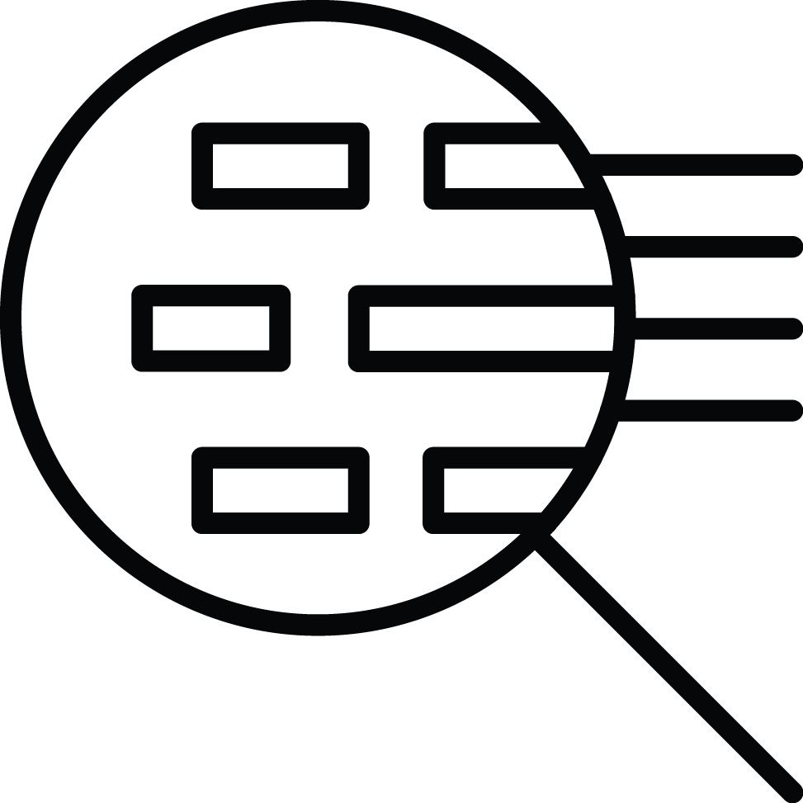
Chatbot: Question Distribution
Watson
Conversation
Here Watson uses reasoning strategies that focus on the language and context of the question.
How do I get a Visa?
I need to visit Zimbabwe as a British citizen with a criminal record—can I do that?
Frequency of Questions
Watson Discovery
Here Watson uses reasoning strategies that focus on identifying the most appropriate answer.
Short Tail
Long Tail
100s
100,000+
Unique Intents
Notes:
- We will use Watson Conversation and Watson Discovery to
answer both short-tail and long-tail questions
- Short-tail questions are typically more PREDICTABLE and
FREQUENT, and will be dealt with by Conversation
- Long-tail questions are typically more SPECIFC, and
retrieved from a KNOWLEDGE BASE, which we will do here
with Discovery

Slide 6

Cognitive Chatbot – common architecture
Watson Discovery
Watson NLU
Notes:
- This is a common Watson Conversation architecture
- Application can use multiple UIs
- FLOW is controlled by Watson Conversation
- INTERFACES to back-end systems when required
- We'll utilise this architecture, using:
- Node-RED for our application,
- HTML, Slack and Telegram as our UIs, and
- Discovery and NLU to enhance our bot

Slide 7
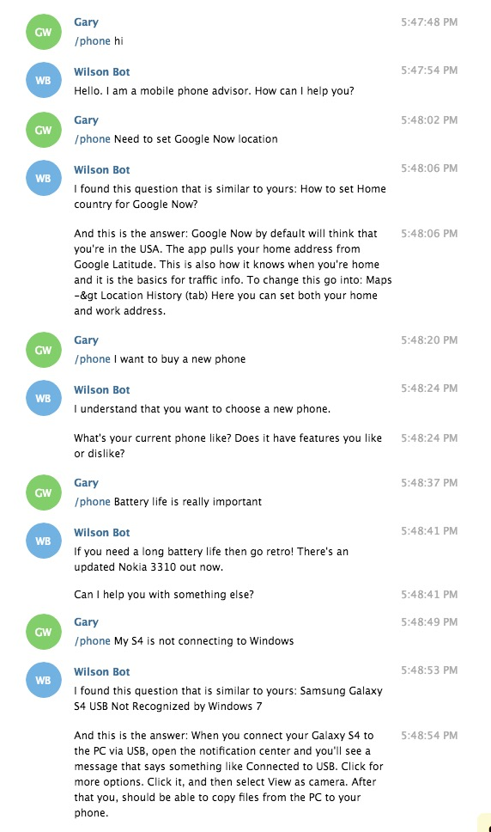
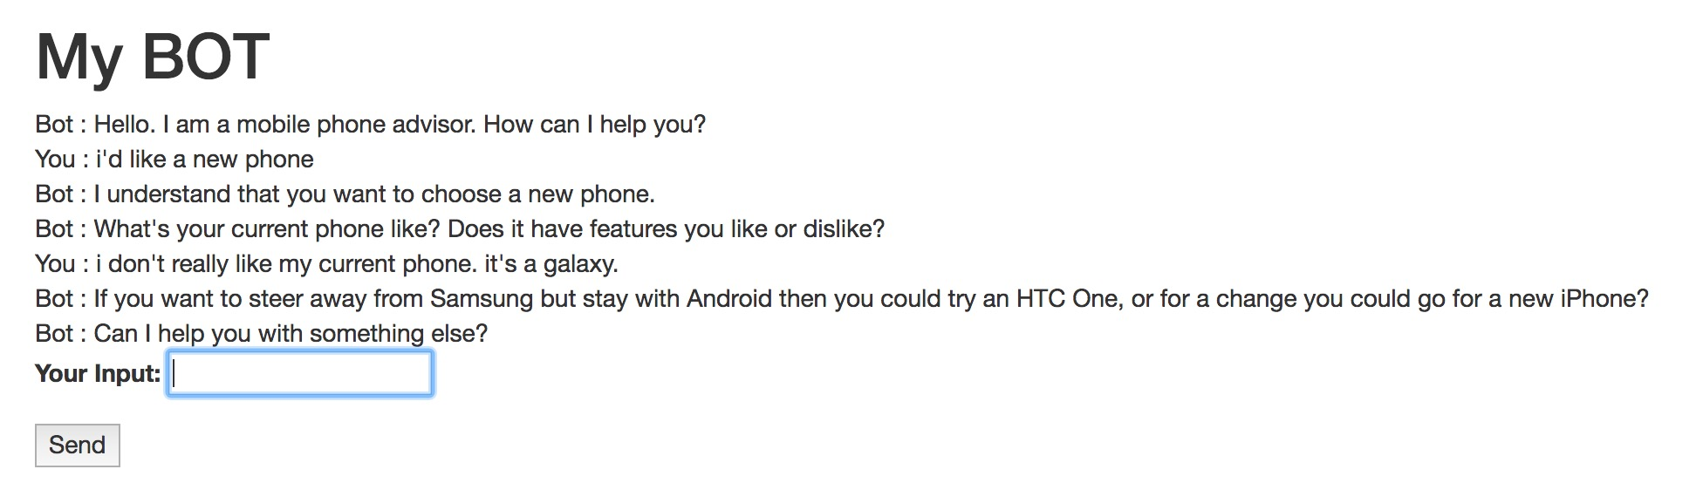
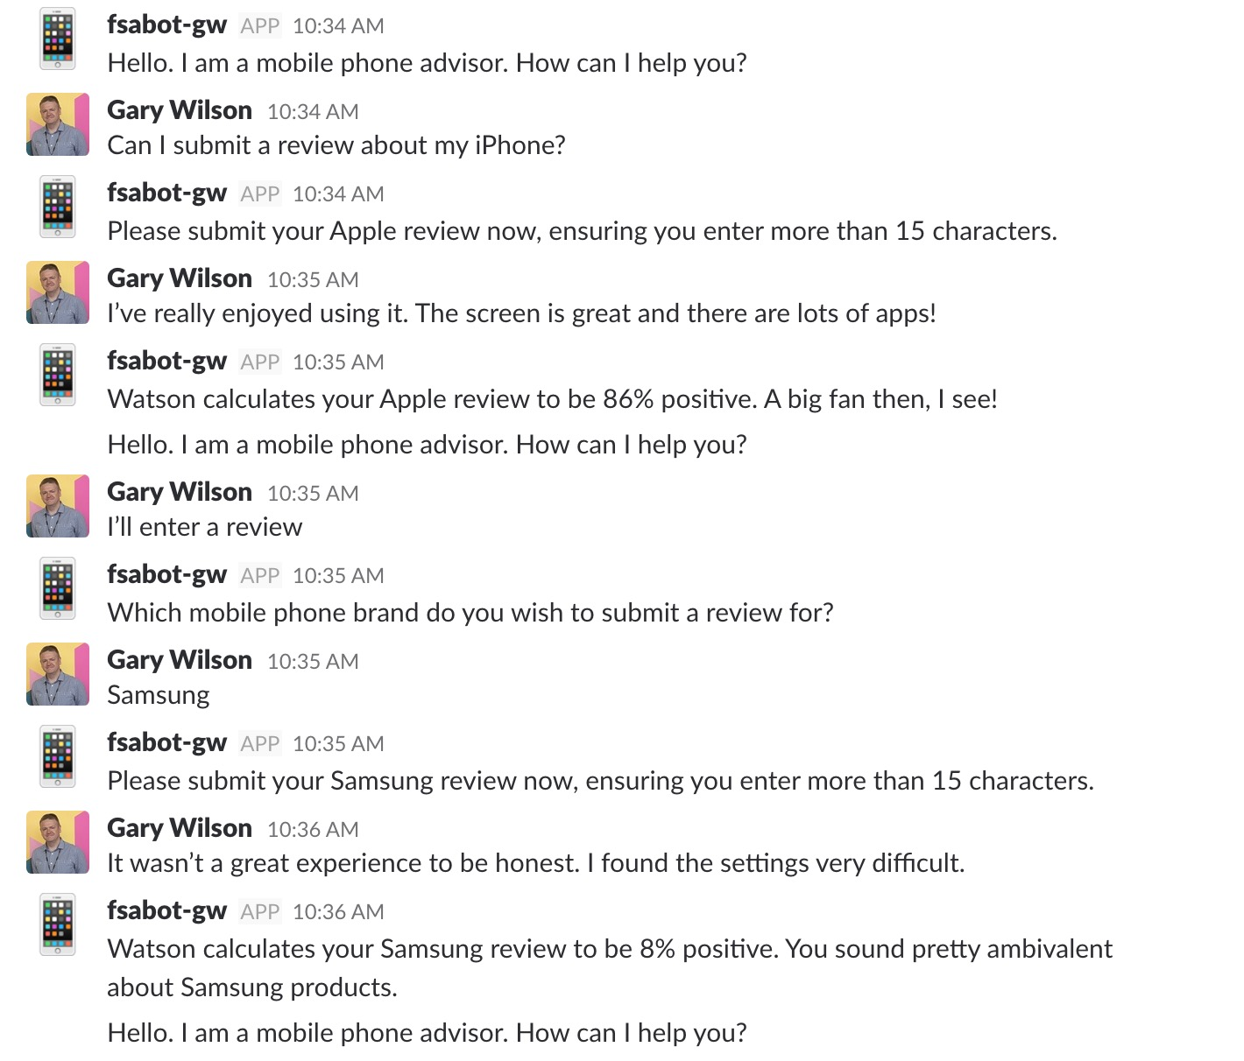
Cognitive Chatbot

Slide 8
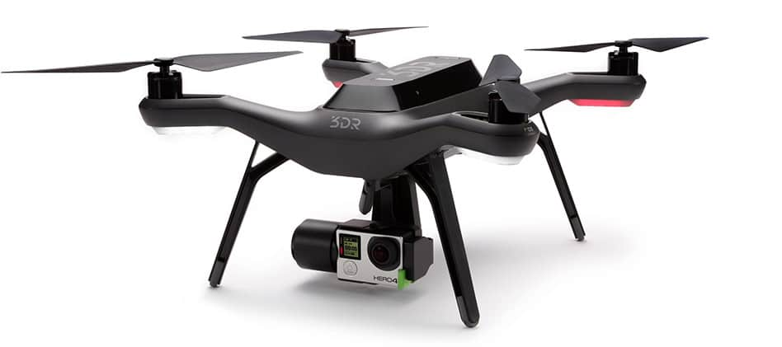
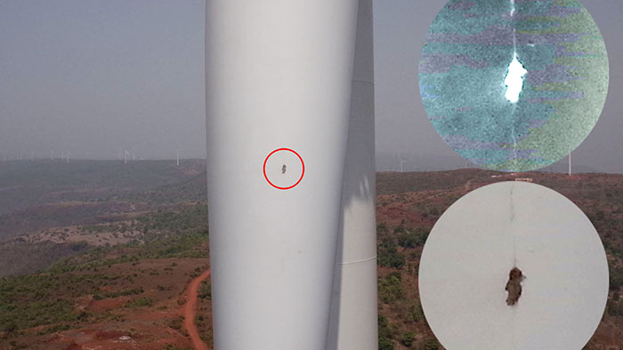
Visual Recognition
Notes:
- Our second app will use Node-RED dashboards and maps, Watson Visual Recognition and Bluemix Object Storage to SIMULATE a drone inspection app
- The app will simulate a drone taking photos of buildings and infrastructure, and provide a CONFIDENCE level for potential FAULTS spotted using Watson VR
- Hopefully this will give you a good grounding in Watson VR, and give you some ideas of how you could APPLY this type of prototype in your own industries

Slide 9
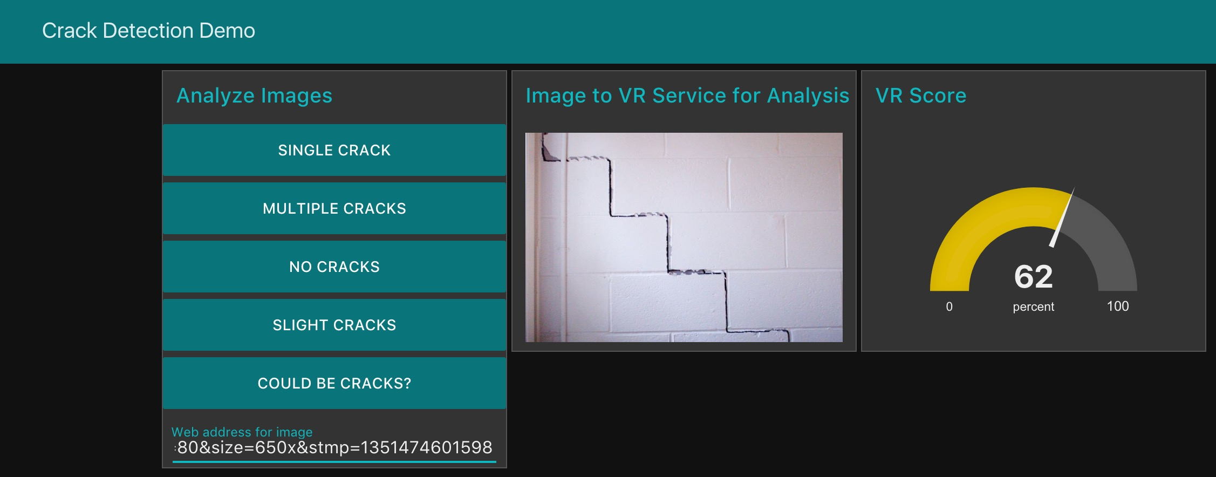
Visual Recognition

Slide 10
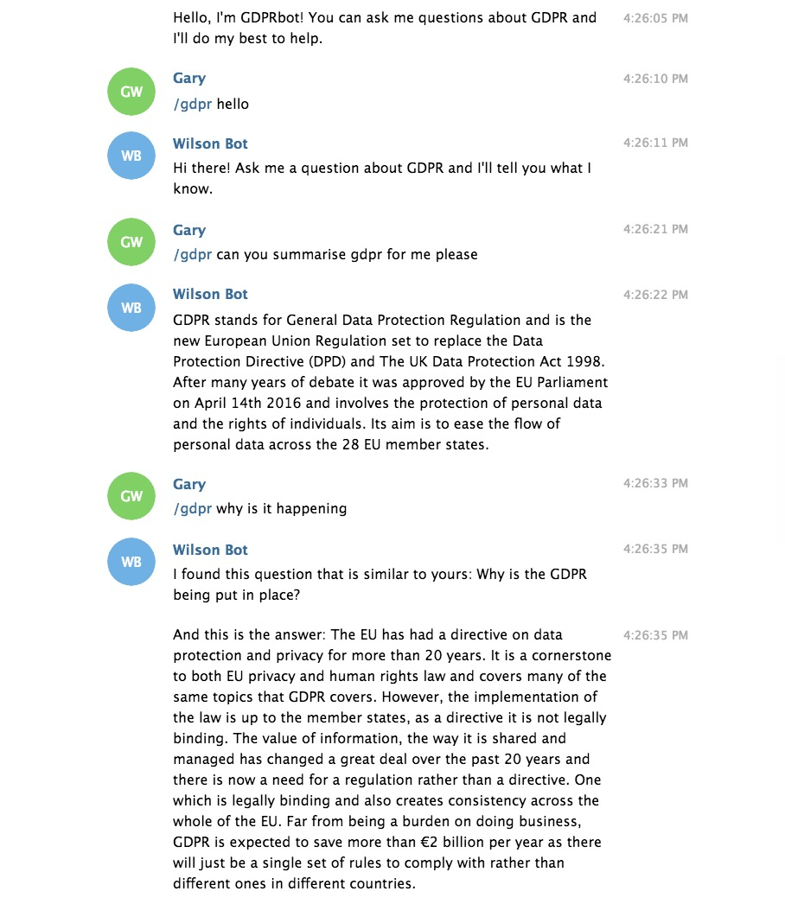
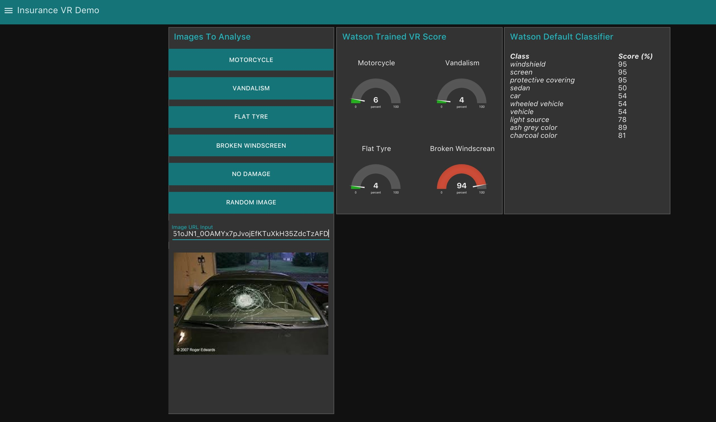
Build A Prototype
GDPR Advisor chatbot
Insurance Claims app
Build Your Own!

Slide 11
Questions?
Cognitive Labs
Gary Wilson – Technical Leader & CTO, UKI Commercial Business
Original Cognitive Labs written by Daniel Chabr and Viliam Valent of the Watson iLab, and modified and extended by Gary Wilson.
The applications used in the Visual Recognition labs were originally created by Douglas McGarrie and Mike Hope.

